Slide 1
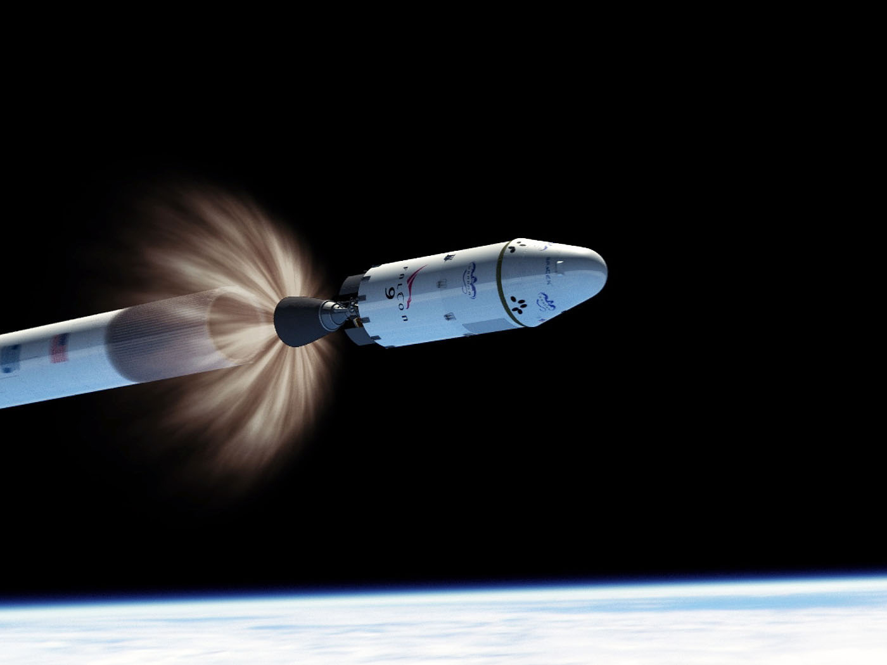

SpaceX First Stage Reuse
Owen Randolph
12/23/2023

Slide 2

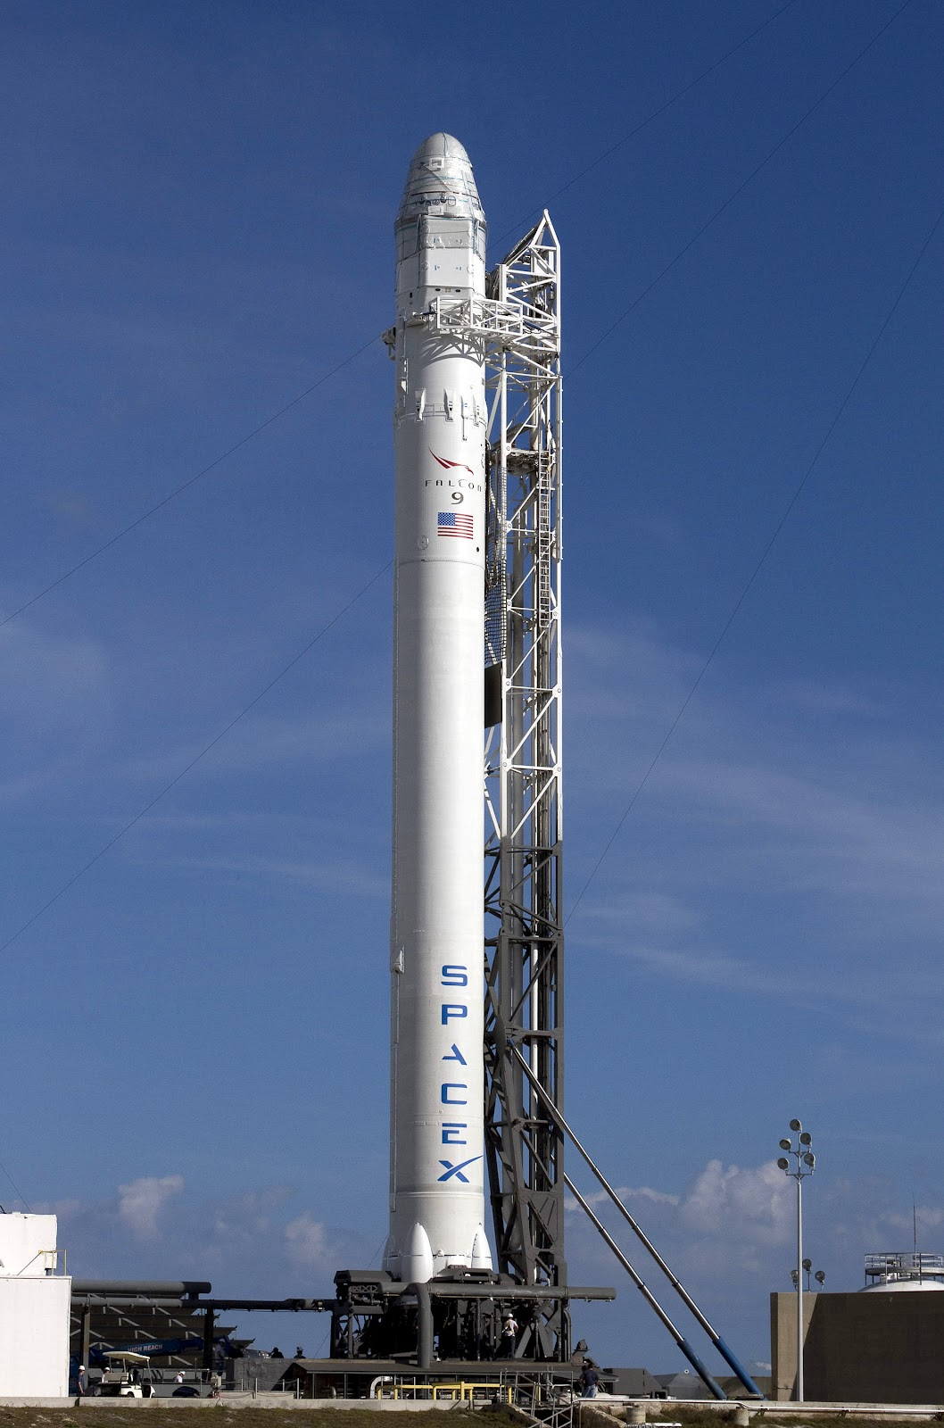
Presentation Contents
Executive Summary
Introduction
Methodology
Results
EDA with Visualization
EDA with SQL
Interactive Maps with Folium
Dashboard with Plotly
Predictive Analytics
Conclusion
Appendix

Slide 3
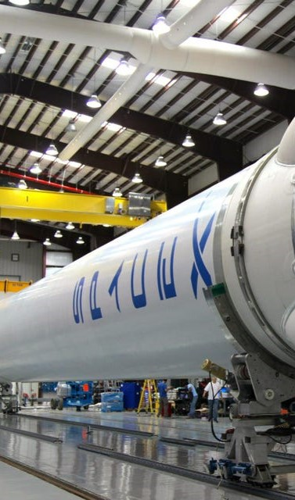
Executive Summary
Methodology:
The study aims to pinpoint key elements contributing to a successful rocket landing. To reach a conclusion, the following methods were used:
Collect Data with RESTAPI and webscraping
Wrangle Data to create success/fail outcome variable
Explore data with visualizations considering payload, launch site, flight number, yearly trend
Analyze data with SQL, calculating: total payload, payload range for successful launches, and total number of successful and failed outcomes
Explore launch site success rates and proximity to geographical features
Visualize launch sites with the highest success and successful payload ranges
Build Models to predict outcome of landings with a variety of machine learning techniques

Slide 4
Executive Summary cont.
Results:
Exploratory Data Analysis
Launches saw more success over time
Kennedy Space center had highest landing site success rate
Orbit Types ES-L1, GEO, HEO, and SSO all had perfect success rates
Visualization
All sites are close to a coast, with most being near the equator
Predictive Analysis
All models performed similarly with test dataset, with the decision tree edging out a win

Slide 5
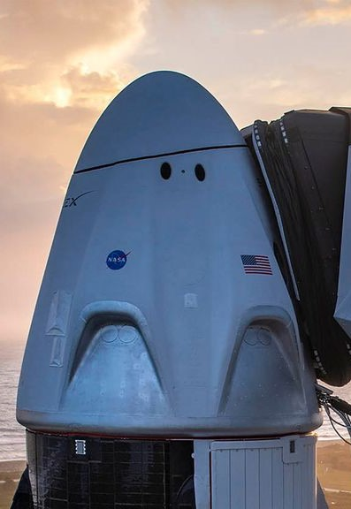
Introduction
Background
SpaceX, the front-runner in the space sector, is committed to making space exploration more accessible. Its notable achievements include dispatching spacecraft to the International Space Station, deploying a satellite network for global internet coverage, and conducting crewed space missions. This is made possible by SpaceX's cost-effective rocket launches, priced at about $62 million each, thanks to the innovative reuse of its Falcon 9 rocket's first stage. In contrast, other providers, unable to reuse the first stage, face launch costs exceeding $165 million. The feasibility of first stage recovery is a key factor in determining launch costs. To assess whether SpaceX or its rivals can reuse the first stage, we can employ publicly available data and machine learning models for prediction.
Explore
Payload mass, launch site, number of flights, and orbits affect the success of first-stage landing
Successful landing rate over time
Optimal Prediction model for landing success

Slide 6

Section 1

Slide 7
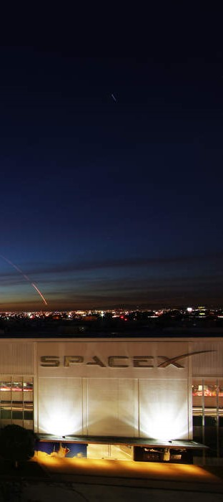
Methodology
Executive Summary
Data collection with SpaceX REST API and web scraping:
Perform data wrangling by filtering data, handling missing values, apply one hot encoding
Perform exploratory data analysis (EDA) using Seaborn and Plotly visualization and SQL queries
Perform interactive visual analytics using Folium and Plotly Dash
Build models to predict landing outcomes using classification models. Tune hyperparameters to find optimal model

Slide 8
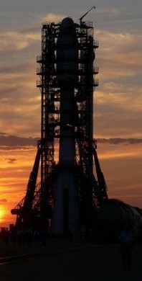
Data Collection – SpaceX API
Steps
Request data from SpaceX API (rocket launch data)
Decode response with .json() and convert into a dataframe using .json_normalize() method
Request information about launches using custom functions
Create dictionary from the data
Create dataframe from the dictionary
Filter dataframe to contain only Falcon 9 launches
Replace missing values of payload mass with .mean()
Export to csv file
Click to view code used (Github)

Slide 9
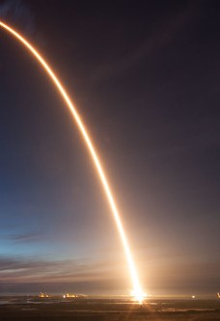
Data Collection - Scraping
Steps
Request data (Falcon 9 launch) from Wikipedia.com
Create BeautifulSoup object from HTML response
Extract column names from HTML table header
Collect data from parsing HTML tables
Create dictionary from data
Create dataframe from dictionary
Export data to csv file
Click to view code used (Github)

Slide 10
Data Wrangling
Steps
Perform EDA and determine data labels
Calculate:
Number of launches for each site
Number and occurrence of orbit
Number and occurrence of mission outcome per orbit type
Create binary landing outcome column
Export data to csv file
Click to view code used (Github)
Landing Outcome
Not always successful
True Ocean: mission outcome had a successful landing to a specific region of the ocean
False Ocean: unsuccessful launch land in the ocean
True RTLS: successful landing on ground pad
False RTLS: unsuccessful landing on ground pad
True ASDS: successful landing on drone ship
False ASDS: unsuccessful landing on drone ship
Outcomes converted into 1 for success and 0 for unsuccessful landing

Slide 11
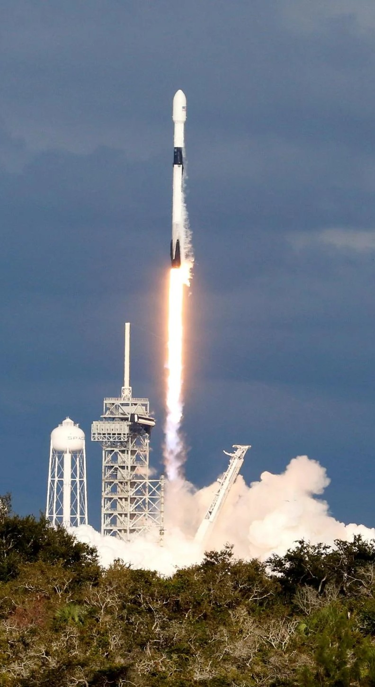
EDA with Data Visualization
Charts
Flight Number vs. Payload
Flight Number vs. Launch Site
Payload Mass (kg) vs. Launch Site
Payload Mass (kg) vs. Orbit type
Analysis
View relationship using scatter plots: variables could be used for machine learning if correlated
Show comparisons among variables with bar charts. Useful for relationships among categories and a measured value

Slide 12
EDA with SQL
Queries
Display:
Names of unique launch sites
5 records where launch site begins with “CCA”
Total payload mass carried by bosters launched by NASA (CRS)
Avg. payload mass by booster version F9 v1.1
Click for code used (Github)
List
First successful launch date on ground pad
Names of boosters that had successful landings on drone ships and a payload mass b/w 4,000 and 6,000 kg
Total mission successes and failures
Booster names carrying max payload
Failed landing outcomes on drone ship
Landing counts b/w 6-4-2010 and 3-20-2017

Slide 13
Build an Interactive Map with Folium
Markers show Launch Sites
Blue circle at NASA’s Johnson Space Center coordinates w/ pop-up label showing its name and coordinates
Red circles at all launch sites coordinates w/ pop-up label showing name and coordinates
Colored Markers of Launch Outcomes
Added colored markers of successful and unsuccessful launches at each site to show site that have high success rates
Colored lines showing distance b/w CCAFS SLC-40 launch site and its proximity to the nearest coastline, railway, highway, and city

Slide 14
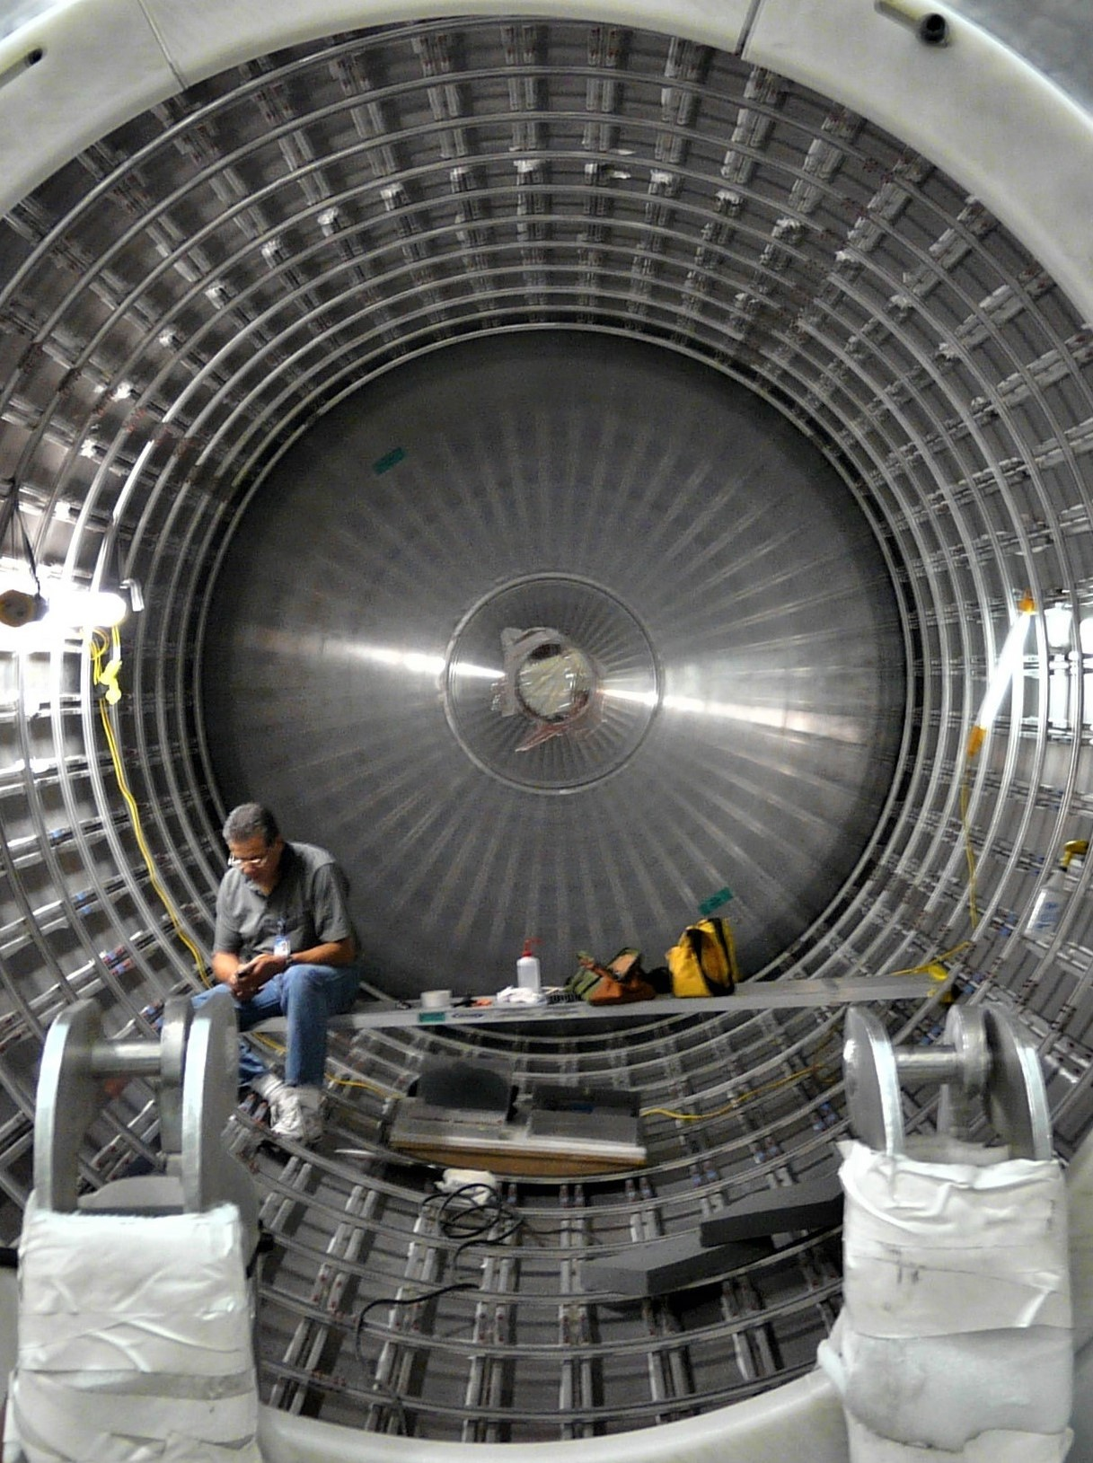
Dashboard with Plotly Dash
Dropdown List w/ Launch Sites
Allows users to select all or certain launch sites
Pie Chart w/ Launch Successes
Allows users to see successes and failures as a percentage of total
Slider of Payload Mass Range
Allows users to select a payload mass range
Scatter Chart Showing Payload Mass vs. Success Rate by Booster
Allows users to see the correlation b/w Payload and Launch success

Slide 15
Predictive Analysis (Classification)
Charts
Create NumPy array from Class column
Standardize data w/ StandardScalar.Fit and transform data
Split data using train_test_split
Create GridSearchCV object w/ cv=10 for parameter optimization
Apply GridSearchCV on various algorithms: Support Vector Machine, Logistic Regression, Decision Tree, K-Nearest Neighbor
Calculate accuracy on the test data using .score() for all models
Assess the confusion matrix for all models
Identify the best model using Jaccard_Score, F1_Score and Accuracy

Slide 16
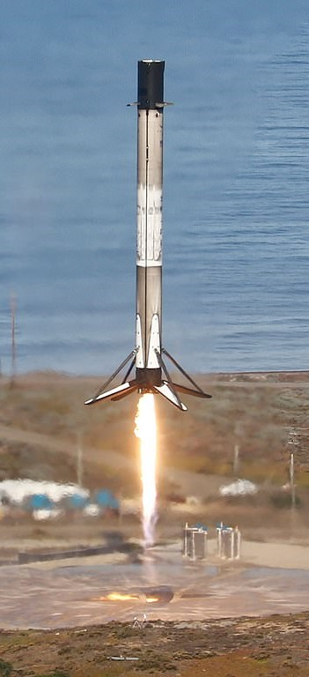
Results
Exploratory Data Analysis
Launch success has improved over time
KSC LC-39A has the highest success rate among landing sites
Orbits ES-L1, GEO, HEO, SSO have a 100% success rate
Visual Analytics
Most launch sites are near the equator, and all are close to the cost
Launch sites are far enough away from anything a failed launch can damage (city, highway, railway), while still close enough to bring people and material to support launch activities
Predictive Analysis
Decision Tree model is the best predictive model for the dataset

Slide 17

Section 2

Slide 18
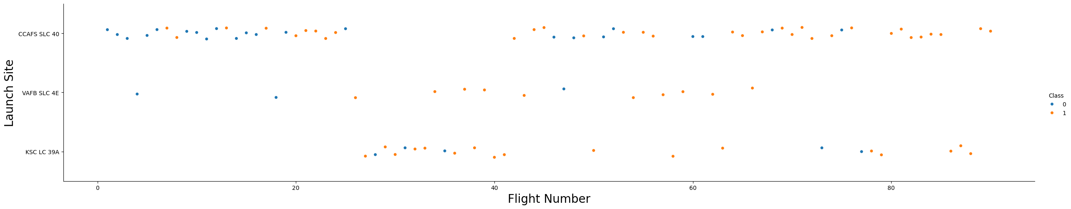
Flight Number vs. Launch Site
Exploratory Data Analysis
Earlier flights had a lower success rate (blue = fail)
Later flights had a higher success rate (orange = success)
Around half of launches were from CCAFS SLC 40 launch site
VAFB SLC 4E and KSC LC 39A had higher success rates
New launches have a higher success rate

Slide 19
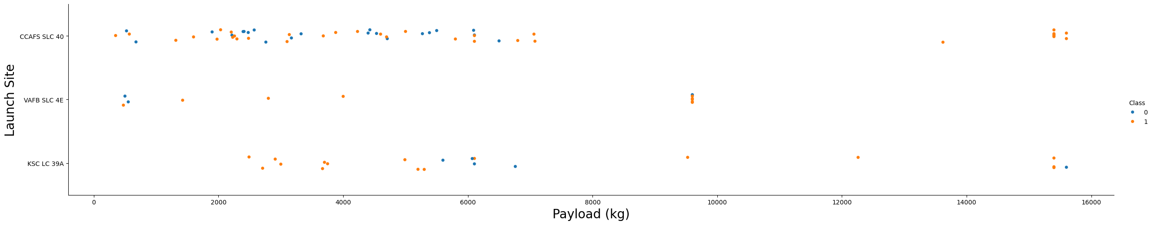
Payload vs. Launch Site
Exploratory Data Analysis
Typically, the higher the payload mass(kg), the higher the success rate
Most launches with a payload greater than 7,000 kg were successful
KSC LC 39A has a 100% success rate for launches less than 5,500 kg
VAFB SKC 4E has not launched anything greater than ~10,000 kg

Slide 20
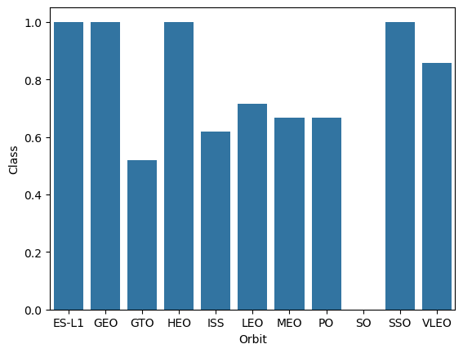
Success Rate vs. Orbit Type
Exploratory Data Analysis
100% Success Rate: ES-L1, GEO, HEO, SSO
50-80% Success Rate: GTO, ISS, LEO, MEO, PO
0% Success Rate: SO

Slide 21
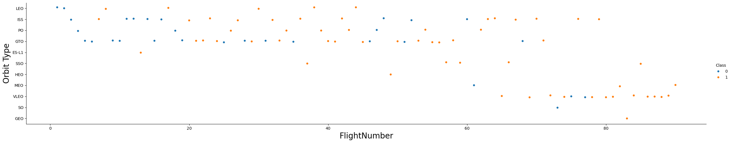
Flight Number vs. Orbit Type
Exploratory Data Analysis
The success rate typically increases with the number of flights for each orbit
The relationship is highly apparent for the LEO orbit
The GTO orbit does not follow this trend

Slide 22
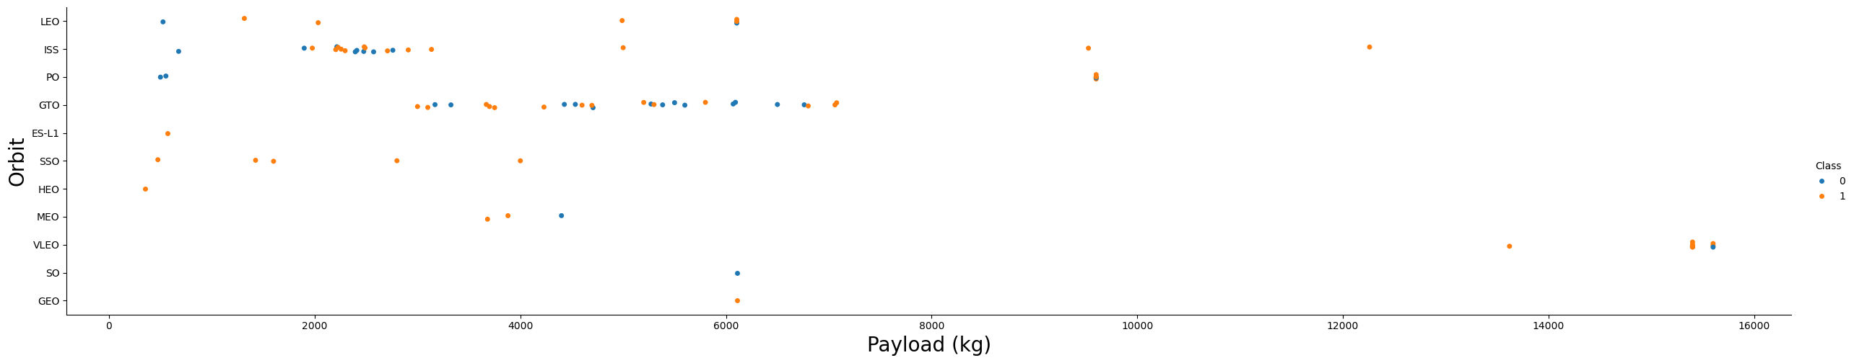
Payload vs. Orbit Type
Exploratory Data Analysis
Heavy Payloads are better with LEO, ISS, and PO orbits
The GTO orbit has mixed success with heavier payloads

Slide 23
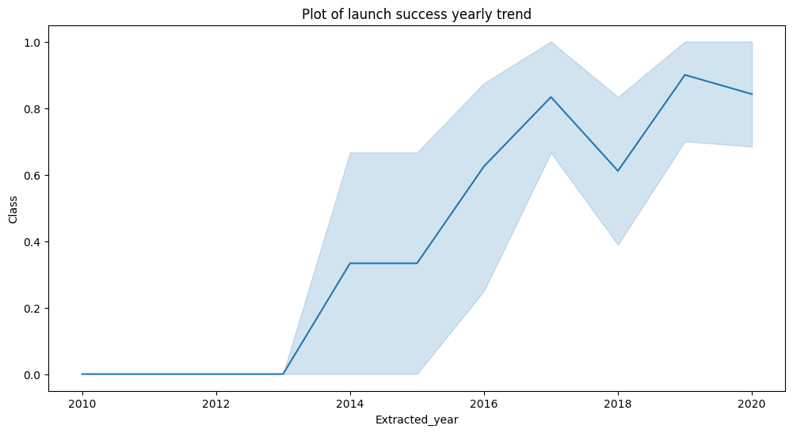
Launch Success Yearly Trend
Exploratory Data Analysis
Success rate improved 2013-2017 and 2018-2019
Success rate dropped 2017-2018 and 2019-2020
Overall, success rate improved since 2013

Slide 24
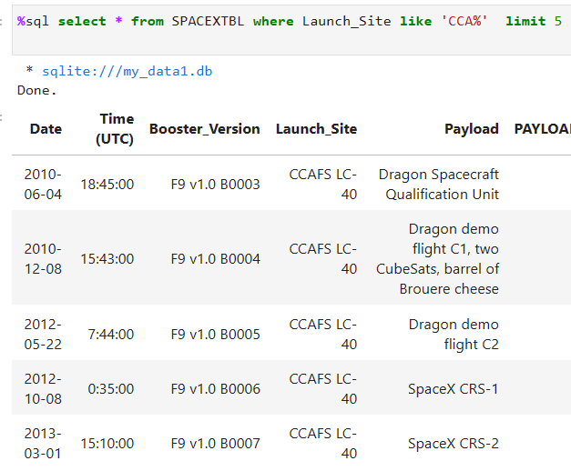
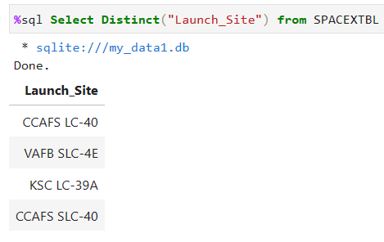
Launch Site Information
Launch Site Names
CCAFS LC-40
CCAFS SLC-40
KSC LC-39A
VAFB SLC-4E
Records of Launch Site Starting with CCA

Slide 25
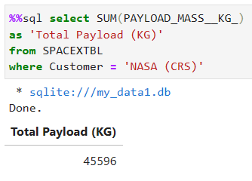
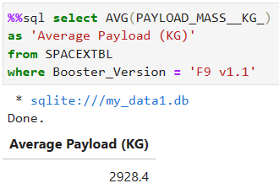
Payload Mass
Total Payload Mass
45,596 kg (total) carried by boosters launched by NASA
Average Payload Mass
2,928.4 kg payload average carried by Falcon 9 booster

Slide 26
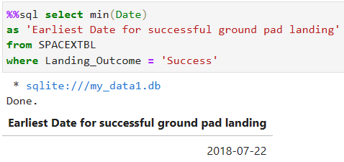
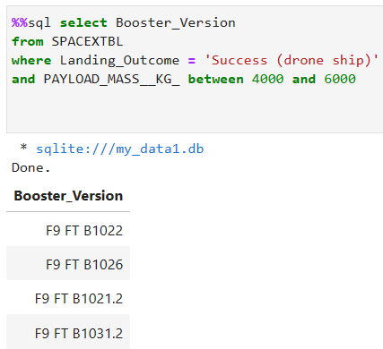
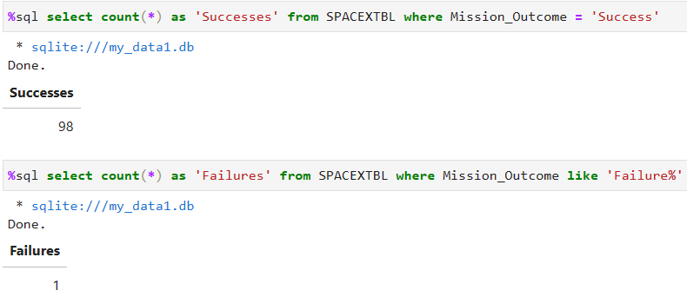
Landing & Mission Info
1st Successful Landing on Ground Pad: 12/22/2015
Booster Drone Ship Landing:
Booster Mass greater than 4,000 and less than 6,000
JSCAT-14, JSCAT-16, SES-10, SES-11 / EchoStar 105
Total Number of Successful and Failed Mission Outcomes
98 Successes, 1 Failure in Flight

Slide 27
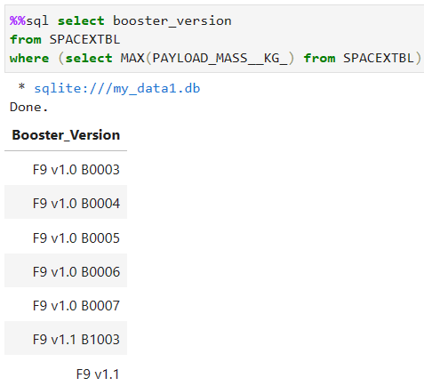
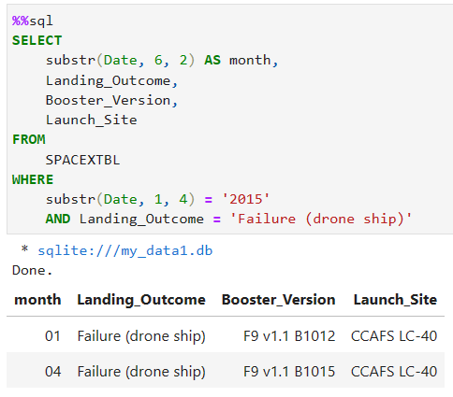
Landing & Mission Info (cont.)
Boosters Carried Maximum Payload
(first 7 shown)
Failed Landing Outcomes in Drone Ship were in January and April

Slide 28
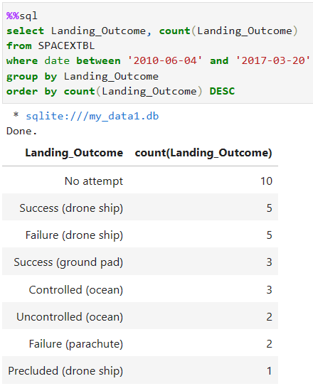
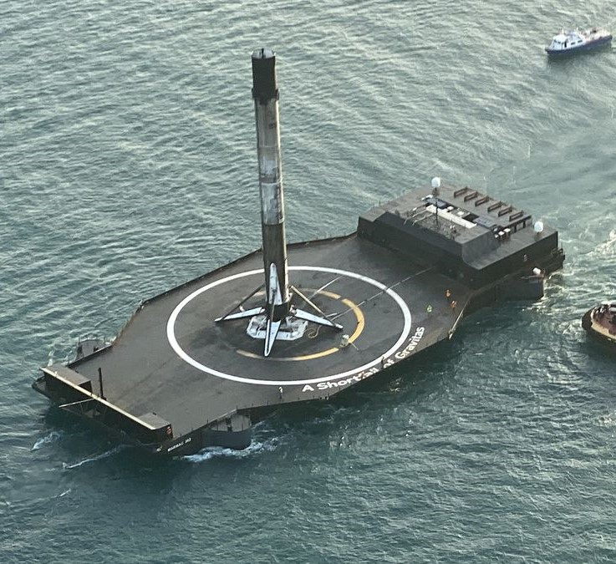
Rank Landing Outcomes Between 2010-06-04 and 2017-03-20
Drone Ship landings were most common, followed by ground pad and ocean landings

Slide 29

Section 3

Slide 30
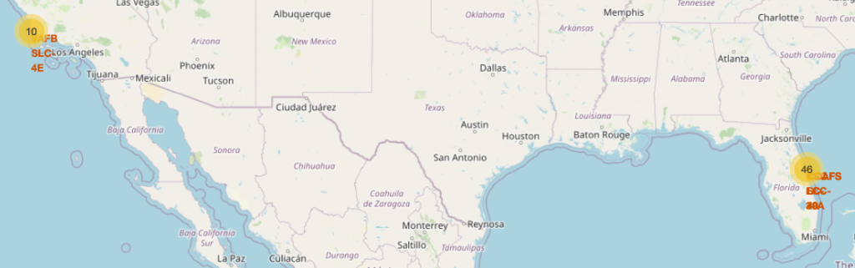
Viewing Sites on a Folium Map
With Markers
Near Equator: the closer the launch site to the equator, the easier it is to launch to equatorial orbit, and the more help you get from Earth’s rotation for a prograde orbit.
Rockets launched from equatorial sites get an additional natural boost, due to the centripetal force of Earth’s rotation, that helps reduce fuel cost and extra booster cost

Slide 31
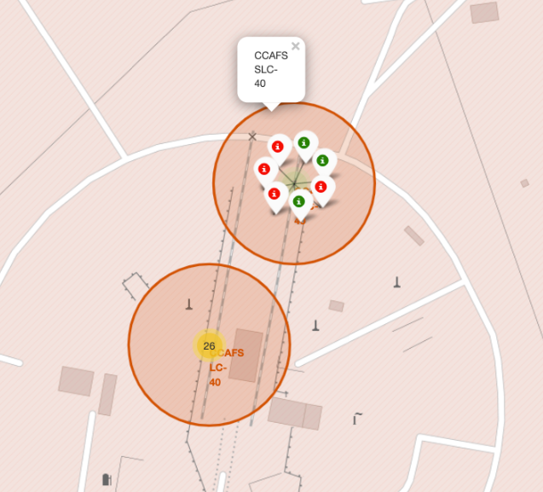
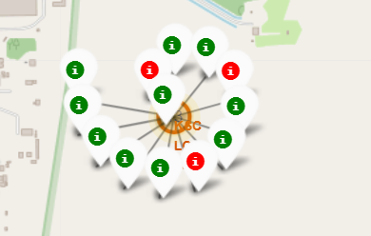
Exploring Launch Success at Each Site
Zooming down to each site, successful launches are marked green and failed launches are marked red

Slide 32
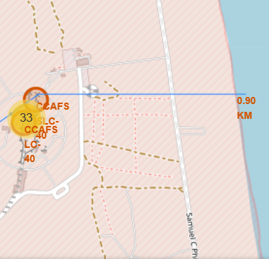
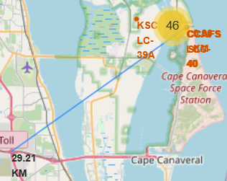
Proximity to Points of Interest Shown on Folium
Proximity to ocean (0.90km) and to the nearest city center (29.21 km) are shown for the Cape Canaveral Site
Helps to ensure spent stages drop into water and not land. Safety and security concerns for the public
Needs to be close enough to transportation infrastructure to be bring materials to launch site

Slide 33

Section 4

Slide 34
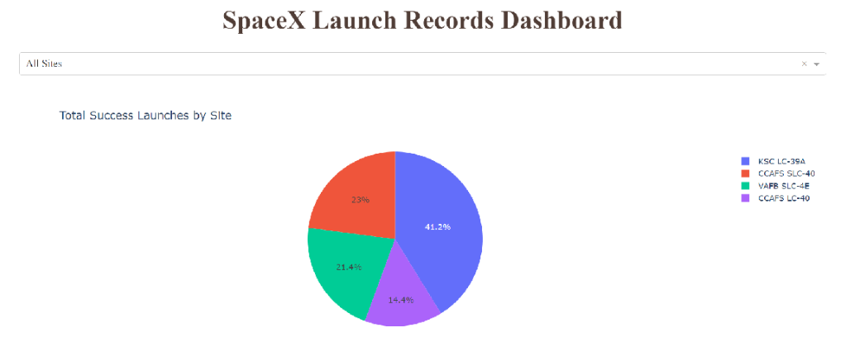
Launch Success by Site
KSC- LC-39A had the most successful launches among launch sites at 41.2%
CCAPS LC-40 had the fewest with 14.4%

Slide 35
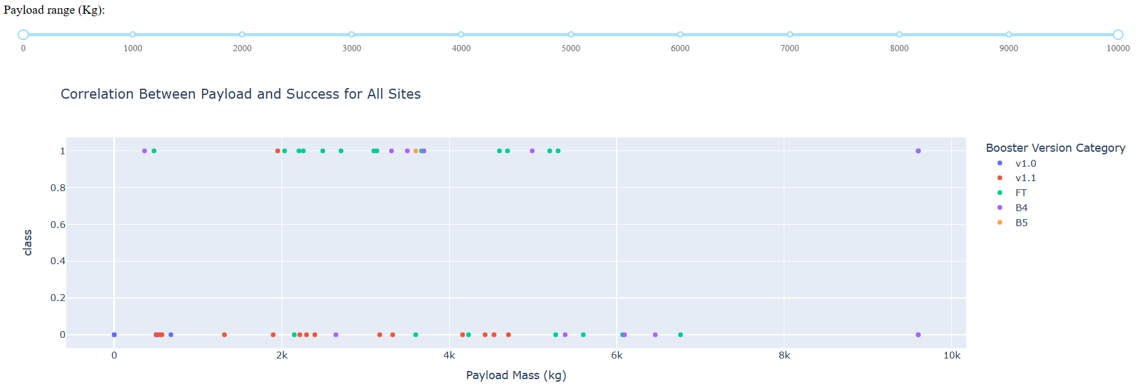
Payload vs. Success Rate
Booster Version FT generally launched the most successful rockets
Most success was achieved using rockets with a payload mass between 2,000 kg and 6,000 kg

Slide 36

Section 5

Slide 37
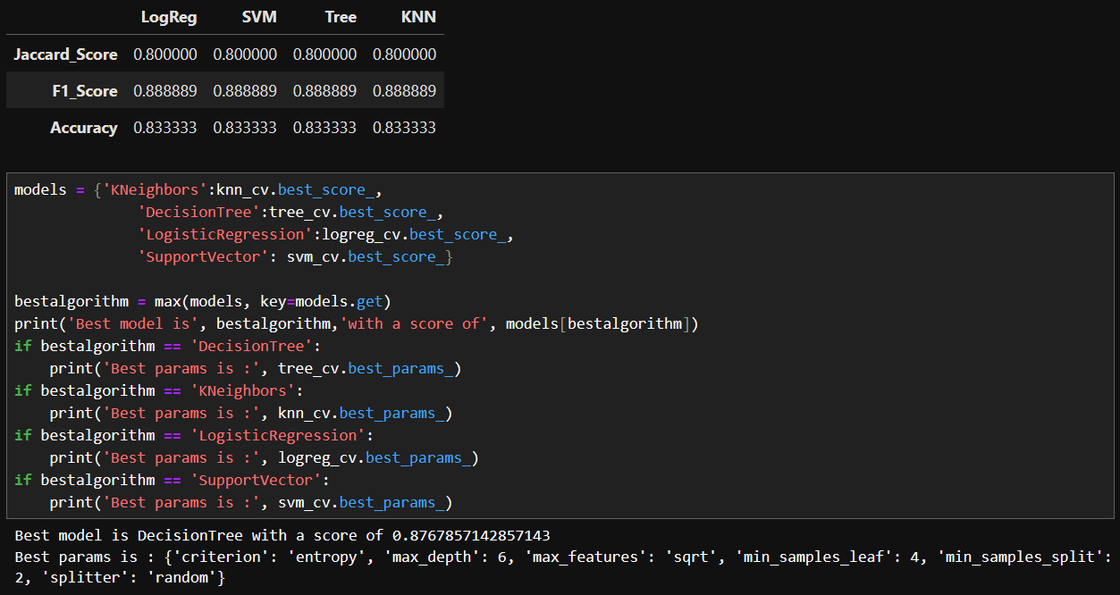
Classification Accuracy
Accuracies of K-Nearest Neighbors, decision tree, and logistic regression were similar, likely due to the size of the data set, but the decision tree was the most accurate model.

Slide 38
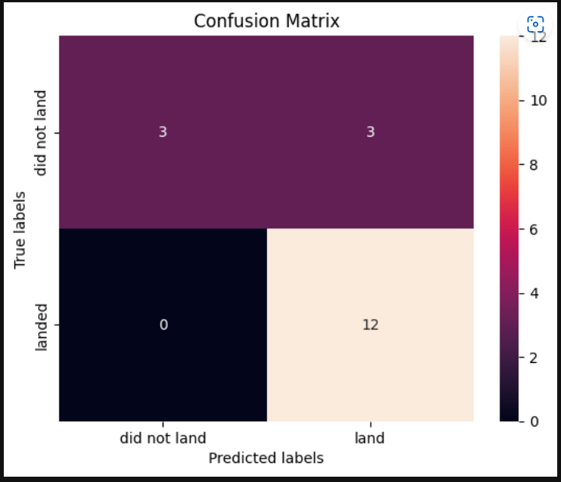
Confusion Matrix
The confusion matrix for the decision tree shows that the classifier can distinguish between the difference classes.
The major problem is False Positives, which are unsuccessful landings marked as successful by the classifier.
Precision = TP / (TP + FP)
12 / (12 + 15) = .80

Slide 39
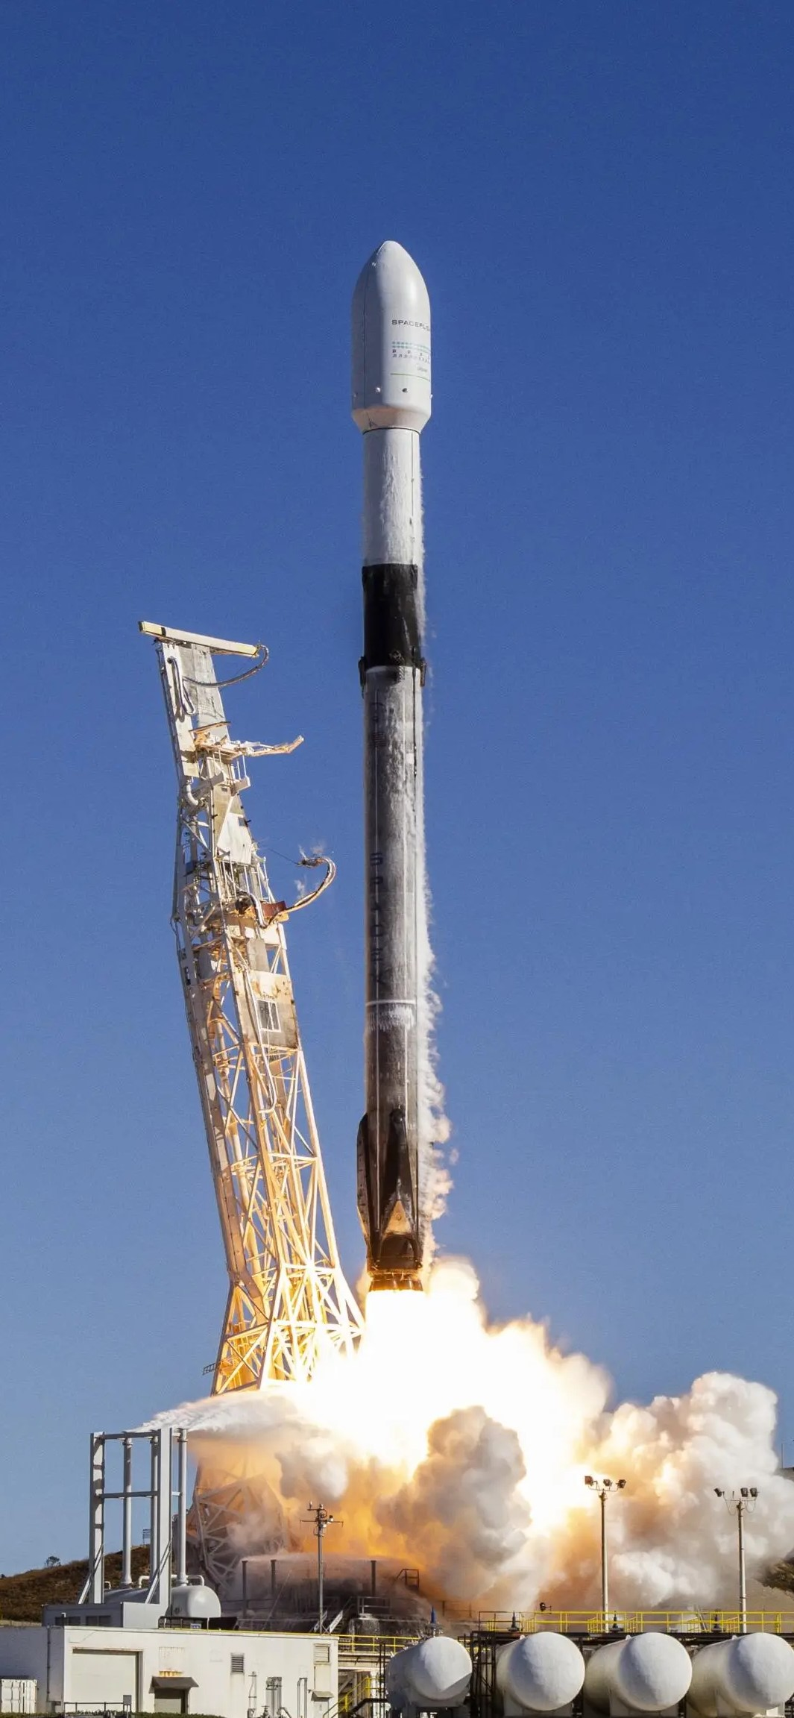
Conclusions
Model Performance: The models performed similarly on the test set with the decision tree outperforming slightly
Equator: Launch sites being near the equator have good locations to keep fuel/additional booster costs down
Coast: All launch sites are near a coast
Launch Success: increases over time
Highest Success Rate among launch sites: KSC LC-39A
Orbits: ES-L1, GEO, HEO, SSO have perfect success rates
Payload Mass: Across all launch sites, the higher the payload mass, the higher the success rate.

Slide 40
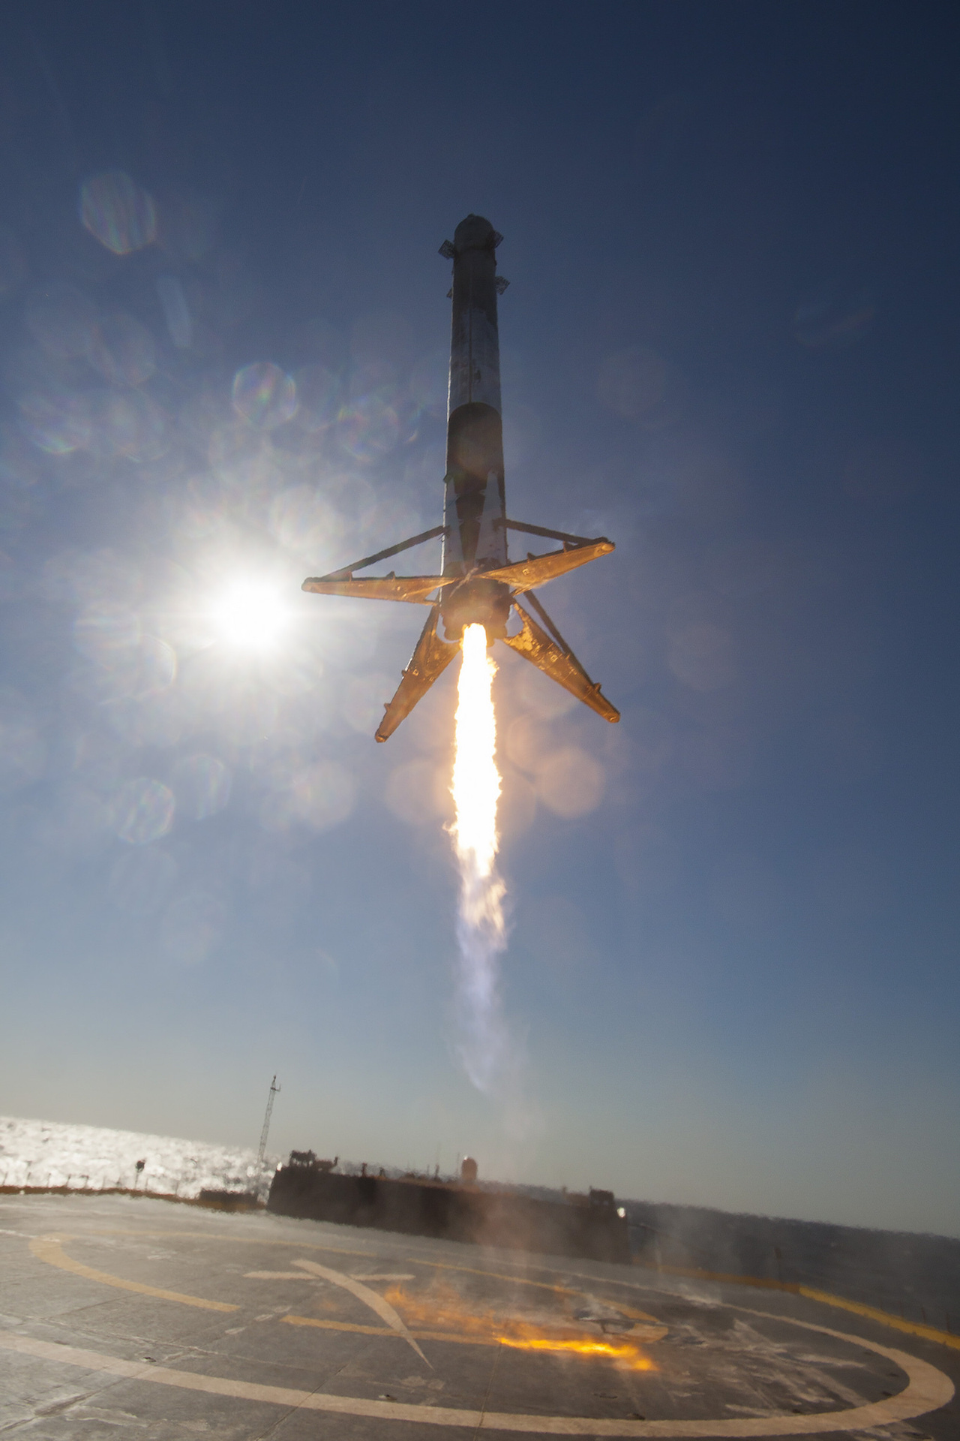
Appendix
Other links to code on Github:
Space X Data set
Data Visualization Charts and Graphs
Dashboard
Folium Maps
Machine Learning Predictions and Comparisons

Slide 41


